Slide 2
Oracle Multi-Channel System of Engagement Solution
Strategy and Overview
Anirban Bagchi
Principal Mobility Specialist
North America Specialized Sales – Mobile & IoT
Notes:
This is a Title Slide with Picture and Logo slide ideal for including a picture and partner or product logo with a brief title, subtitle and presenter information.
To customize this slide with your own picture:
Right-click the slide area and choose Format Background from the pop-up menu. From the Fill menu, click Picture and texture fill. Under Insert from: click File. Locate your new picture and click Insert.
To Replace the LOGO on this sample slide:
Right-click the sample LOGO and choose Change Picture. Navigate to the location where the new logo is stored, select desired logo file and click on the Open button to replace the sample logo.

Slide 3
Notes:
This is a Safe Harbor Front slide, one of two Safe Harbor Statement slides included in this template.
One of the Safe Harbor slides must be used if your presentation covers material affected by Oracle’s Revenue Recognition Policy
To learn more about this policy, e-mail: Revrec-americasiebc_us@oracle.com

Slide 4
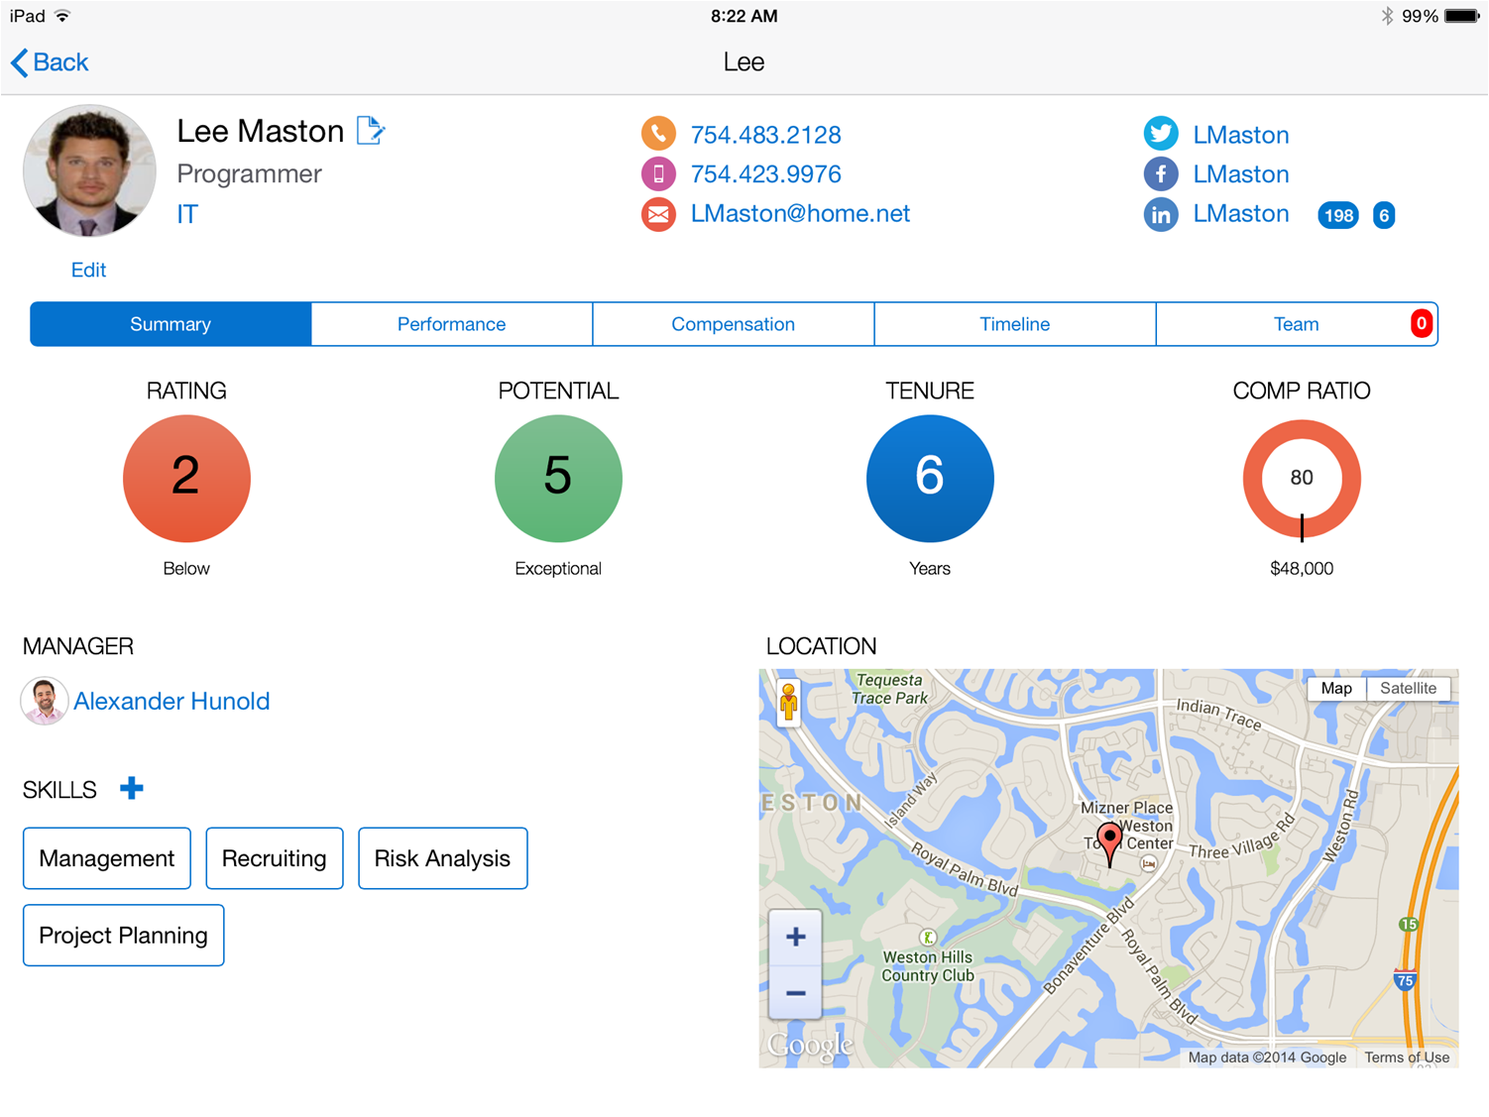
Lets start with a Mobile App. A simple HR Mobile App
Notes:
Enterprises today are building applications which put Imagine that as a mobile developer you were asked to build a mobile app that looked like this – a very simple, elegant HR mobile designed for the HR rep or a manger to use. This screen in this looks relatively simple and has all the data the user needs about their employee.
It has information about the employee, their contact details, their social networking information, their performance information, talent management information, their location etc.
Overall a simple app to build.

Slide 5
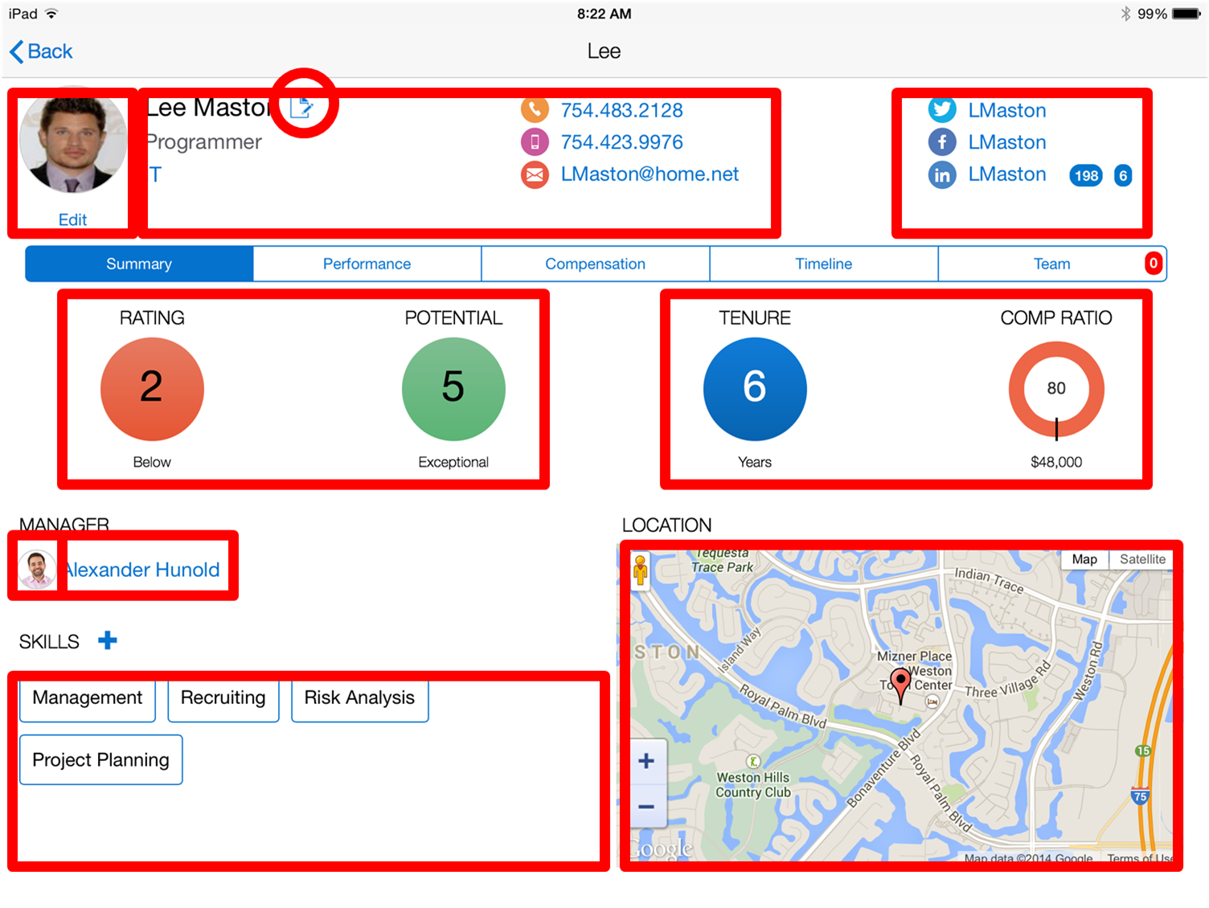
Let’s decompose this app
Notes:
However, when you now start to decompose the app and start highlight the different areas you are mashing up the data for this app, you will realize that (go to the next slide)

Slide 6
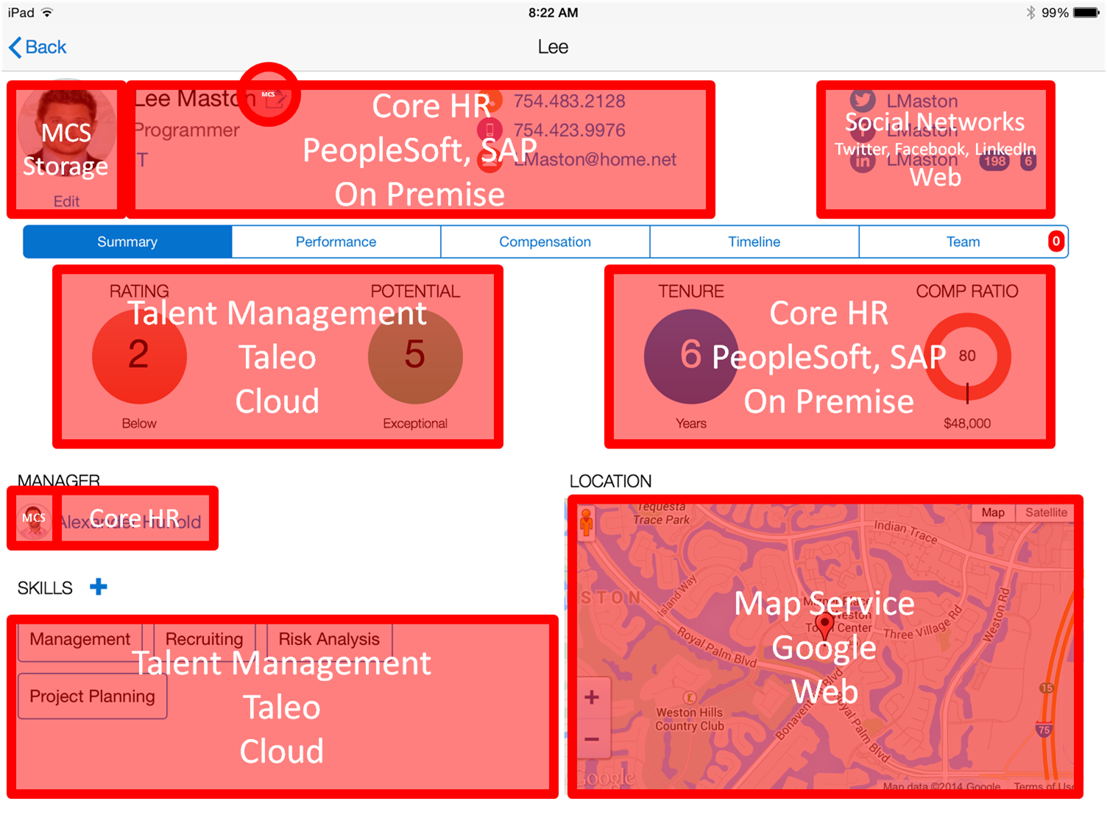
And map it to the systems of record
Notes:
That in fact this simple app is quite complex in that you need to integrate data from multiple systems of record. For e.g. let’s say the HR systems were different based by geo – on premise (SAP in Europe and Oracle PeopleSoft in US), the talent information came from Taelo – a SaaS app Social networking came from LinkedIn, FB and Twitter. Mapping service from Google. This enterprise wants to store employee photo but the backends may not be set up for storing images.
While creating the front end is a relative easy task trying to integrate this data, map user identity and security policies and getting different APIs together is what takes the longest time

Slide 7

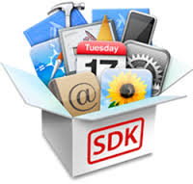























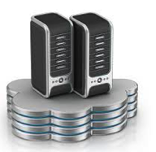
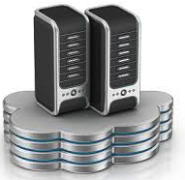

This simple app soon became complicated to develop…
Client Dev Tools
Monitor & Analyze
Mobile Services
Integration
Security
Multiple Environments
Notes:
So now the mobile developer has to figure out
What tool will they use to build the mobile, native or cross platform ?
How do they integrate to these multiple systems of record – 7 in this case
What are the user identity policies for these backend systems. They may be different based on the authentication policy of the backend
IT would need to provide environments for dev, test and prod – multiple environments since the app is not static and will have continuous development
What about adding mobile services like the ability to work in an offline mode, to get push notifications, add geo coding to the employee record
What about diagnostics, analytics to determine how the app is performing, who is using the app etc
In summary, there is a lot that goes on in building a mobile app. Building the UI becomes the easy part. The hard part is managing all these other areas.

Slide 8
This simple app soon became complicated to develop…
Client Dev Tools
Monitor & Analyze
Mobile Services
Integration
Security
Multiple Environments
Notes:
So now the mobile developer has to figure out
What tool will they use to build the mobile, native or cross platform ?
How do they integrate to these multiple systems of record – 7 in this case
What are the user identity policies for these backend systems. They may be different based on the authentication policy of the backend
IT would need to provide environments for dev, test and prod – multiple environments since the app is not static and will have continuous development
What about adding mobile services like the ability to work in an offline mode, to get push notifications, add geo coding to the employee record
What about diagnostics, analytics to determine how the app is performing, who is using the app etc
In summary, there is a lot that goes on in building a mobile app. Building the UI becomes the easy part. The hard part is managing all these other areas.

Slide 9
Need approach to develop Multi-Channel solutions
System of Engagement Driven Design and Development
End user is most important.
Application design is based on end users usability requirements
Top notch consumer market grade end user experience is key to providing a rich system of engagement
Start immersive app development project top down with the UX definition, defining what end users want to see, feel and experience.
System of Record Agnostic Approach - API Hub on the Cloud
APIs will provide the abstraction to the data and process.
Data and process can be anywhere, on-prem/cloud, new/existing, DB/SaaS.
Create and manage enterprise APIs on the cloud
API provides agility for fast change
API contracts ensure rapid parallel development of multi-channel UX and services.

Slide 10
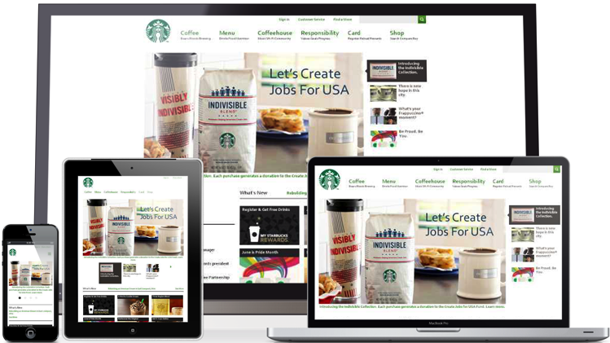





The Answer – Mobile Cloud Service
Making Mobile Simple
Mobile
Cloud Service
Consumer style
front-end experience
Enterprise grade
backend
Systems of Record
&
Services
Notes:
So what is the answer to solving these problems – Mobile Cloud Service or Multi-Channel Cloud Service will become your API Hub on the Cloud
Whether it is consumers or employees, they expect superior front end experience, tying to a secure enterprise grade backend service that connects and integrates to multiple systems of record and services.

Slide 11
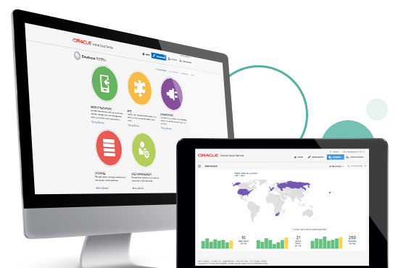
Oracle Mobile Cloud Service
Simplifying Enterprise Mobility: Easily connect mobile app to enterprise backend services & security
Speed Innovation & Agility: Keep pace with business needs, create personalized engagement
Reduce Cost: Reduce cost & risk of mobile connectivity to enterprise data centers
Personalize Engagements: Measure, analyze, engage and increase mobile ROI
Oracle Confidential – Highly Restricted
Notes:
MC benefits:
Speed innovation and agility –
keep pace with business needs and mobile app client development,
Add mobile centric features – push, sync, storage, diagnostics, analytics,
Get insights into Mobile Portfolio ROI
Reduce cost –
Reduce risk of mobile connectivity into enterprise data centers
Get insights into Mobile Portfolio ROI
Simplify Enterprise Mobility:
easily connect mobile app to enterprise backend services & security
Hire less experienced mobile developers and enable them with enterprise grade services
Increase mobile adoption and personalize engagement

Slide 12






Geared for all involved Personas
Line of Business Stakeholders
“I am responsible for the success of our mobilization strategy”
Enterprise Architect
“I make sure we have a secure, scalable solution”
Mobile App Developer
“I create the mobile applications that call backend services”
Service Developers
MCS Admin
MCS Admin
“I administer MCS for our company”
.
Service Developers
“I create the backend services that mobile applications call”
LOB Stakeholder
Enterprise Architect
Mobile Developer
Notes:
Any successful mobile application is a collaboration among multiple groups within the enterprise. Gartner recommends a bimodal approach to unite IT teams and combine agility with stability to address digital opportunities. MCS was designed with a persona based approach with a deep understanding on the roles and needs of these personas and the tools required to make it easy for these personas to deliver on their roles and functions and to collaborate with the other personas. A quick look at the personas, focal with Mobile Cloud Service.
All starts with the LOB Stake holder that has the business requirement – they are responsible for the overall success of the mobile app.
Mobile client developer – responsible for building the client side engaging experiences and consuming services provided from the mobile backend
Service developers – developing or shaping services for mobile client developers to consume
IT Architect – ensuring IT security and architecture compliance
MCS admin – managing the operational maintenance of MCS

Slide 13



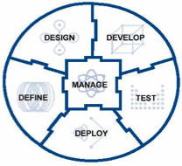



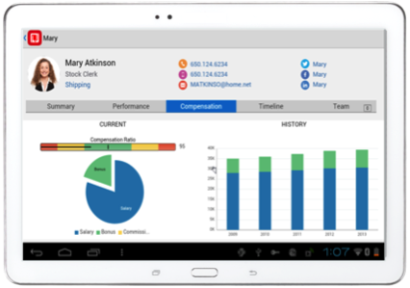
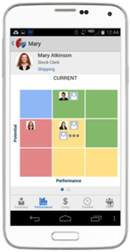



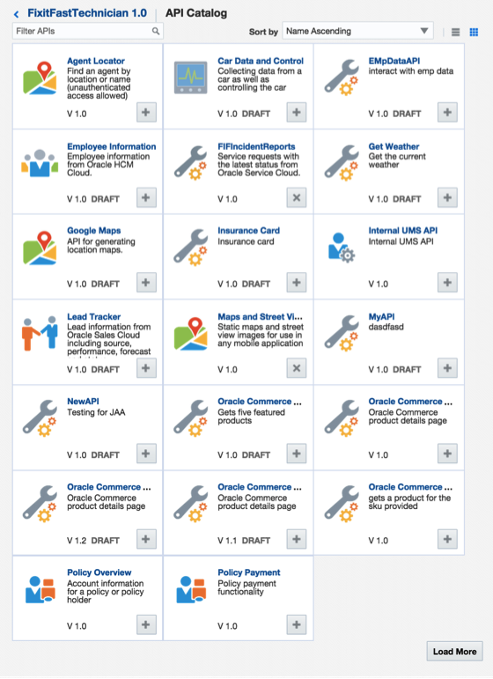


















Oracle Mobile Cloud Service
Outside-in, Mobile First
Analytics
Continuous Development
MOBILE APPLICATION FRAMEWORK
Diagnostics
Usage
Engagement
Monitoring
Inside-out, Service first
SDLC
Built-in APIs
Offline Sync
User Mgmt
Native
Mobile
Cloud Service
ICS
OSB / SOA
Cloud
Notifications
Storage
Connectors
Mobile APIs / SDKs
SECURE
Public Cloud
Oracle Cloud
Enterprise SaaS
On-premise
On-Premise Packaged Applications
3rd Party API
Others
Custom API
Users
Data Shaping
Objs
Custom
Logic
Orchestrate
CUSTOM Applications
Notes:
The Oracle Mobile Service goal is to easily enable mobile application developers that are continually looking for new ways to accelerate development of apps to meet their consumers’ needs. MCS is a set of cloud-based, server-side mobile services to make app development quicker and easier to deploy. MCS reduces the complexities of the application development by dealing with the complex server side programming, reducing the redundancy in creating backend code blocks, providing ready to integrate features and template backend.
Developers can focus more on the front end of the applications and can have their choice of mobile client development tools including ADF-Mobile for cross platform hybrid apps, native development or other Javascript tools – creating a new meaning for BYOD – Bring your own development
MCS provides a set of rich RESTFul interfaces for all the operations required by the mobile app that abstracts the backend from the mobile developer. In addition it also provides mobile specific interfaces for notification (multi channel – app, SMS), offline data sync, persistence services (to store mobile generated data and user preferences) as cloud data storage service.
From a backend perspective, MCS provides all the tools required by API developers to expose and shape the services to be consumed by the mobile developer. This includes mechanisms to design, create and expose these services in a catalog that can be easily and securely discoverable by mobile developers and integrated into their app.
Security is a critical component and is designed ground up in the MCS. From tokens to developers to develop and consume APIs to encryption policies for data in rest, data in motion, policies for single sign on and federated authentication across multiple data sources via Oauth or SAML and policies for defining access rights to applications via mobile application management or container technologies are services that will be available in MCS
A key component of MCS is to provide developers, IT and business with metrics on service usage and business impact. MCS will be designed to provide technical metrics, engagement metrics, business metrics along with the monitoring and management of the service.

Slide 14
Mobile Cloud Service Demo
14

